Slide 1




Slide 2
Agenda
1.1 Introduction to DBMS
1.2 DBMS-ER Model
1.3 DBMS-Relational Model
1.4 Introduction to SQL and keys
1.5 UML

Slide 3
1.1 Introduction to DBMS
Data – It is known facts and statistics stored over a network, generally it's Raw and unprocessed.
For Ex: When you visit any website, they might store you IP address, that is data, in return they might add a cookie in your browser, marking you that you visited the website, that is data, your name, it's data, your age, it's data.
Data information when it is processed, turning it into something meaningful.
Based on the cookie data saved on user's browser, if a website can analyse that generally men of age 20-25 visit us more, that is information, derived from the data collected.
Record: Collection of related data items, e.g. in the above example the three data items had no meaning. But
if we organize them in the following way, then they collectively represent meaningful information.
Table or Relation: Collection of related records.
DATABASE :
Database is a collection of related data organised in a way that data can be easily accessed, managed and updated. Database can be software based or hardware based, with one sole purpose, storing data.
Roll | Name | Age
1 | XYZ | 19

Slide 4
1.1 Introduction to DBMS
Defn:A database-management system (DBMS) is a collection of interrelated data and a set of programs to access those data. The collection of data, usually referred to as the database
DBMS – software that allows creation, definition and manipulation of database, allowing users to store, process and analyse data easily
DBMS provides us with an interface or a tool, to perform various operations like creating database, storing data in it, updating data, creating tables in the database and a lot more.
Here are some examples of popular DBMS used these days:
MySql
Oracle
SQL Server
IBM DB2
PostgreSQL
Amazon SimpleDB (cloud based) etc.

Slide 5
Characteristics of DBMS
Data stored into Tables: Data is stored into tables, created inside the database. DBMS also allows to have relationships between tables which makes the data more meaningful and connected. Y
Reduced Redundancy: In the modern world hard drives are very cheap, but earlier when hard drives were too expensive, unnecessary repetition of data in database was a big problem. But DBMS follows Normalisation which divides the data in such a way that repetition is minimum.
Data Consistency: On Live data, i.e. data that is being continuously updated and added, maintaining the consistency of data can become a challenge. But DBMS handles it all by itself.
Support Multiple user and Concurrent Access: DBMS allows multiple users to work on it(update, insert, delete data) at the same time and still manages to maintain the data consistency.
Query Language: DBMS provides users with a simple Query language, using which data can be easily fetched, inserted, deleted and updated in a database.
Security: The DBMS also takes care of the security of data, protecting the data from un-authorised access. In a typical DBMS, we can create user accounts with different access permissions, using which we can easily secure our data by restricting user access.
DBMS supports transactions, which allows us to better handle and manage data integrity in real world applications where multi-threading is extensively used.

Slide 6
Applications of DBMS
Enterprise Information
Sales: For customer, product, and purchase information.
Accounting: For payments, receipts, account balances, assets and other accounting information.
Human resources: For information about employees, salaries, payroll taxes, and benefits, and for generation of paychecks.
Manufacturing: For management of the supply chain and for tracking production of items in factories, inventories of items in warehouses and stores, and orders for items.
Online retailers: For sales data noted above plus online order tracking,generation of recommendation lists, and maintenance of online product evaluations.
Banking and Finance
Banking: For customer information, accounts, loans, and banking transactions.
Credit card transactions: For purchases on credit cards and generation of monthly statements.
Finance: For storing information about holdings, sales, and purchases of financial instruments such as stocks and bonds; also for storing real-time market data to enable online trading by customers and automated trading by the firm.
Universities: For student information, course registrations, and grades (in addition to standard enterprise information such as human resources and accounting).
Airlines: For reservations and schedule information. Airlines were among the first to use databases in a geographically distributed manner.
Telecommunication: For keeping records of calls made, generating monthly bills, maintaining balances on prepaid calling cards, and storing information about the communication networks.

Slide 7
Purpose of DBMS
To allow users to manipulate the information, the system has a number of application programs that manipulate the files, including programs to:
• Add new students, instructors, and courses
• Register students for courses and generate class rosters
• Assign grades to students, compute grade point averages (GPA), and generate
Transcripts.
Tradinational storage/Conventional storage
A file system is a technique of arranging the files in a storage medium like a hard disk, pen drive, DVD, etc. It helps you to organizes the data and allows easy retrieval of files when they are required. It mostly consists of different types of files like mp3, mp4, txt, doc, etc. that are grouped into directories.
A file system enables you to handle the way of reading and writing data to the storage medium. It is directly installed into the computer with the Operating systems such as Windows and Linux.

Slide 8
Drawbacks of Using File Processing Systems
1.Data redundancy and inconsistency
Data Redundancy and Data Inconsistency are the important terms used in the Database. A good Database Design is the one in which there is minimum Data Redundancy and Data Inconsistency.
Data Redundancy It is defined as the redundancy means duplicate data and it is also stated that the same parts of data exist in multiple locations into the database. This condition is known as Data Redundancy.
Problems with Data Redundancy : Wasted Storage Space.
More Difficult Database Update.
It will lead to Data Inconsistency.
Retrieval of data is slow and inefficient.
Data Inconsistency : When the same data exists in different formats in multiple tables. This condition is known as Data Inconsistency. It means that different files contain different information about a particular object or person. This can cause unreliable and meaningless information. Data Redundancy leads to Data Inconsistency.

Slide 9
Drawbacks of Using File Processing Systems
2.Difficulty in accessing data
Suppose that one of the university clerks needs to find out the names of all students who live within a particular postal-code
area.
The clerk asks the data-processing department to generate such a list.
Because the designers of the original system did not anticipate this request, there is no application program on hand to meet it. There is, however, an application program to generate the list of all students. The university clerk has now two choices: either obtain the list of all students and extract the needed information manually or ask a programmer to write the necessary application program.
Several days later, the same clerk needs to trim that list to include only those students who have taken at least
60 credit hours. Which is then is iterative process.
Note: The point here is that conventional file-processing environments do not allow needed data to be retrieved in a convenient and efficient manner.
3.Data isolation. Because data are scattered in various files, and files may be in different formats, writing new application programs to retrieve the appropriate data is difficult.

Slide 10
Drawbacks of Using File Processing Systems
4.Integrity problems. The data values stored in the database must satisfy certain types of consistency constraints. Suppose the university maintains an account for each department, and records the balance amount in each account.
Suppose also that the university requires that the account balance of a department may never fall below zero.
Note: The problem is compounded when constraints involve several data items from different files.
5.Atomicity problems
A computer system, like any other device, is subject to failure. In many applications, it is crucial that, if a failure occurs, the data be restored to the consistent state that existed prior to the failure.
Consider a program to transfer $500 from the account balance of department A to the account balance of department B. If a system failure occurs during the execution of the program, it is possible that the $500 was removed from the
balance of department A but was not credited to the balance of department B, resulting in an inconsistent database state. Clearly, it is essential to database consistency that either both the credit and debit occur, or that neither occur.
That is, the funds transfer must be atomic—it must happen in its entirety or
not at all.

Slide 11
Drawbacks of Using File Processing Systems
4.. The data values stored in the database must satisfy certain types of consistency constraints. Suppose the university maintains an account for each department, and records the balance amount in each account.
Suppose that the university requires that the account balance of a department may never fall below zero.
Note: The problem is compounded when constraints involve several data items from different files.
5.Atomicity problems
A computer system, like any other device, is subject to failure. In many applications, it is crucial that, if a failure occurs, the data be restored to the consistent state that existed prior to the failure.
Consider a program to transfer $500 from the account balance of department A to the account balance of department B. If a system failure occurs during the execution of the program, it is possible that the $500 was removed from the
balance of department A but was not credited to the balance of department B, resulting in an inconsistent database state. Clearly, it is essential to database consistency that either both the credit and debit occur, or that neither occur.
That is, the funds transfer must be atomic—it must happen in its entirety or
not at all.

Slide 12
Drawbacks of Using File Processing Systems
6.Concurrent-access anomalies.
For the sake of overall performance of the system and faster response, many systems allow multiple users to update the data simultaneously.
Today, the largest Internet retailers may have millions of accesses per day to their data by shoppers.
In such environment, interaction of concurrent updates is possible and may result in inconsistent data.
7.Security problems.
Not every user of the database system should be able to access all the data.
For example, in a university, payroll personnel need to see only that part of the database that has financial information.
They do not need access to information about academic records.
But, since application programs are added to the file-processing system in an ad hoc manner, enforcing such security constraints is difficult.

Slide 13
Advantages of DBMS | Disadvantages of DBMS
Segregation of application program. | It's Complexity
Minimal data duplicacy or data redundancy. | Except MySQL, which is open source, licensed DBMSs are generally costly.
Easy retrieval of data using the Query Language. | They are large in size.
Reduced development time and maintenance need.
With Cloud Datacenters, we now have Database Management Systems capable of storing almost infinite data.
Seamless integration into the application programming languages which makes it very easier to add a database to almost any application or website.

Slide 14
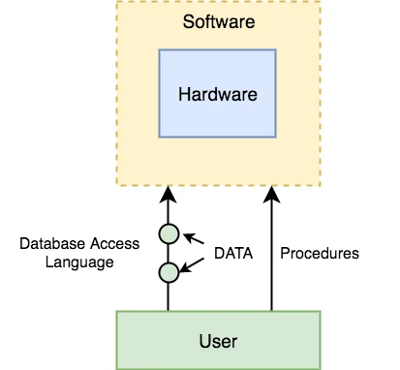
Components of DBMS
The database management system can be divided into five major components, they are:
Hardware - computer, hard disks, I/O channels for data, and any other physical component involved before any data is successfully stored into the memory.
Software - provides us with an easy-to-use interface to store, access and update data.
Data - source of DBMS, Metadata(data about data) is stored
Procedures -general instructions to use a database management system
Database Access Language - simple language designed to write commands to access,
insert, update and delete data stored in any database.
Users
Database Administrators: Database Administrator or DBA is the one who manages the complete database management system.
Application Programmer or Software Developer: This user group is involved in developing and designing the parts of DBMS.
End User: These days all the modern applications, web or mobile, store user data.

Slide 15
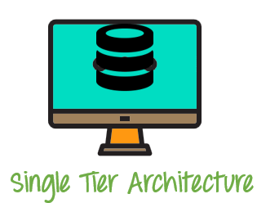
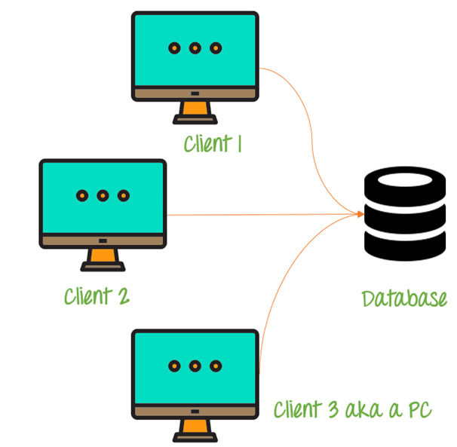
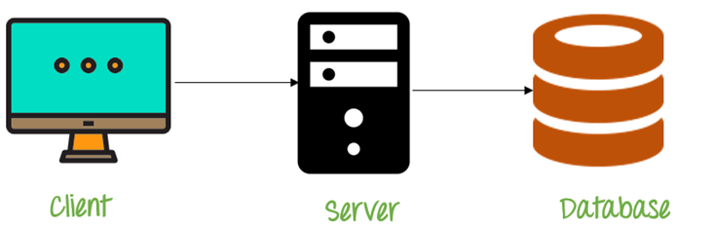
DBMS ARCHITECHTURE
A Database Management system is not always directly available for users and applications to access and store data in it.
A Database Management system can be Centralised(all the data stored at one location), Decentralised(multiple copies of database at different locations) or hierarchical, depending upon its architecture.
1-tier DBMS
Database is directly available to the user for using it to store data.
Database resides on the same machine. Eg.Local machine
2-tier DBMS
Presentation layer runs on Client(PC, Mobile, Tablet etc..)
Data is stores on a server .
2 Tier Architecture
3-tier DBMS
Presentation layer (your PC, Tablet, Mobile, etc.)
Application layer (server)
Database Server
3 Tier Architecture

Slide 16
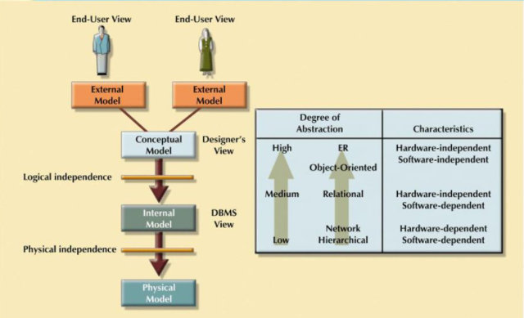
DBMS Schemas-Level of Abstraction
A major purpose of a database system is to provide users with an abstract view of the data
Three Levels of Abstraction
Internal Level/Physical : Physical storage structures and access paths(how the data are actually stored)
Conceptual level or Logical: Structure and constraints for the entire database(what data are stored in the database, and what relationships exist among those data).This is referred as Physical Data Independence.
External or View level: The highest level of abstraction describes only part of the entire database. The view level of abstraction
exists to simplify their interaction with the system.

Slide 17
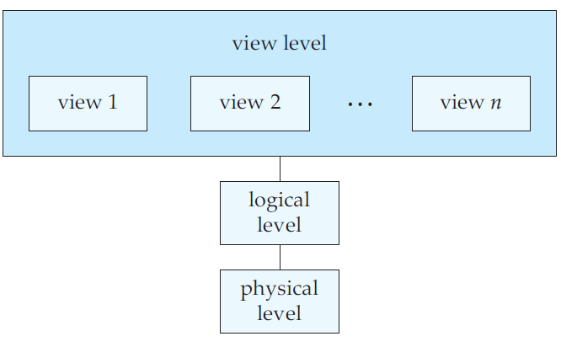
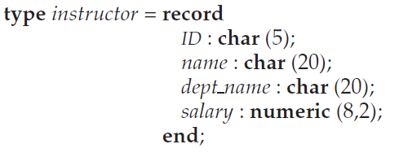
DBMS Schemas-Level of Abstraction

Slide 18
DBMS Schemas-Instances and Schemas
The collection of information stored in the database at a particular moment is called an instance of the database.
The overall design of the database is called the database schema.
Database systems have several schemas, partitioned according to the levels of abstraction
Physical schema describes the database design at the physical
Logical schema describes the database design at the logical level.
A database may also have several schemas at the view level, sometimes called subschemas
Data Models
Structure of a database is the data model: a collection of conceptual tools for describing data, data relationships, data semantics, and consistency constraints.

